Slide 1
From Learning Goals to Due Dates
A Teaching Matters Workshop on Syllabus (re)Design
Dr. William FitzGerald

Slide 2
Definition
Plan (how you conceive the course)
Guide (how you map the course)
Contract (what you promise and expect)

Slide 3
Plan - Syllabus as Building Block
Learning Goals
Modes of Instruction
Means of Assessment

Slide 4
Guide - Syllabus as Blueprint
The syllabus as…
Orienting document
Nuts and bolts handbook
Rhetorical stance

Slide 5
Contract - Syllabus as Handshake
Expectations
Caveats
Mutual accountability

Slide 6
Learning Goals
Measurable, Manageable, Meaningful
Student-centered
Grounded in Continuous Improvement

Slide 7
Learning Goals
Three categories:
Knowledge
Skills
Abilities/Attributes

Slide 8
Writing Learning Goals
Initial draft: Students will be familiar with the major theories of conflict resolution.
Revision: Students will be familiar with withdrawal, smoothing, forcing, compromising, and problem solving.
Further revision: Students will summarize the concepts of withdrawal, smoothing, forcing, compromising, and problem solving.
Specific: Students will summarize the five major approaches to conflict resolution: withdrawal, smoothing, forcing, compromising, and problem solving.
Higher order thinking objective: Students will choose and defend a conflict resolution approach appropriate for a given situation.
Source: University of Oregon Teaching Effectiveness Program

Slide 9
Example: Biochemistry and Molecular Biology at Wooster
Upon completion of the major, we intend that a BCMB student will...
1. Possess a broad and fundamental understanding of biology and chemistry with particular focus on how molecules found in biological systems confer the properties of living organisms.
2. Be able to perform the common methods and use the tools of the field including laboratory and computational techniques.
3. Have the ability to conduct independent scientific investigation and scientific inquiry.
4. Be able to locate, evaluate, and communicate scientific information effectively both by written and oral presentation.

Slide 10
Example: Economics at Bucknell
Majors in Economics will be able to:
Identify and analyze mainstream and heterodox economic concepts, theories and tools.
Summarize, explain, and critically analyze economic arguments orally and in writing.
Locate and interpret economic data.
Locate, interpret and assess sources of economic information.
Develop skills and knowledge that provide a foundation for pursuing lifelong learning and a socially responsible life.

Slide 11
Example: History of Art at Middlebury
Students in the major will, by inquiring into the modes and meanings of visual arts and culture:
develop their abilities as critical thinkers by questioning works of art and architecture and developing arguments about the circumstances of their production and meaning
learn to build extended arguments based upon composite evidence: visual, historical, and textual
engage creative research problems that, over time, yield new insights into art, architecture, history and culture
become strong, convincing writers through using a variety of approaches to write about the history of the arts, architecture, and visual culture
become highly skilled at presenting their work through oral, public presentations

Slide 12
Assignments
Meaningful
Connected to learning goals
Clear

Slide 13
Mapping Learning Goals to Assignments
Three examples from The Chronicle of Higher Ed

Slide 14
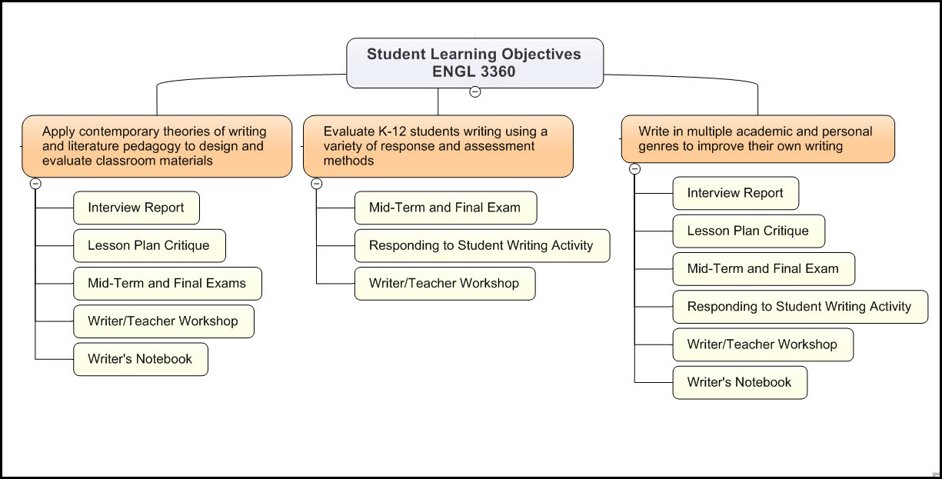

Slide 15
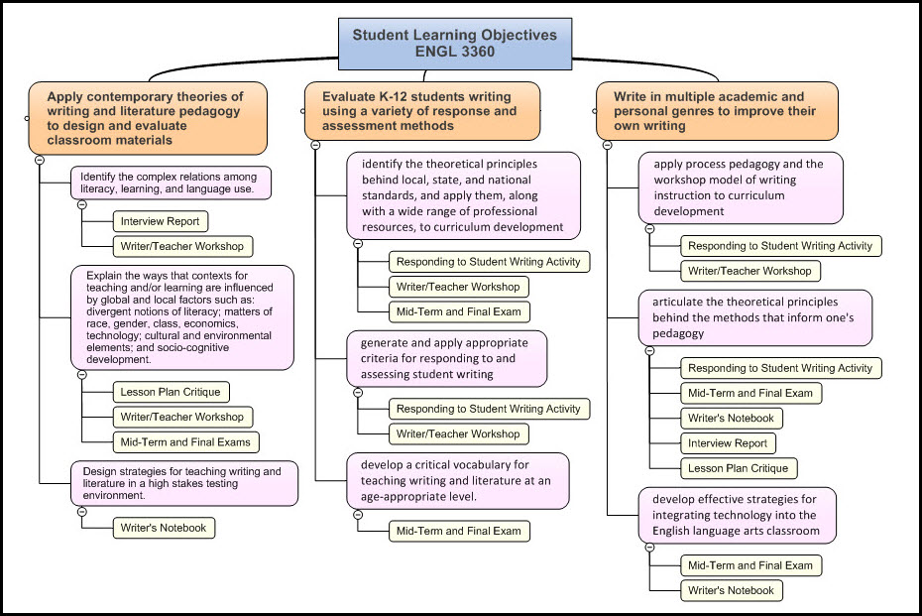

Slide 16
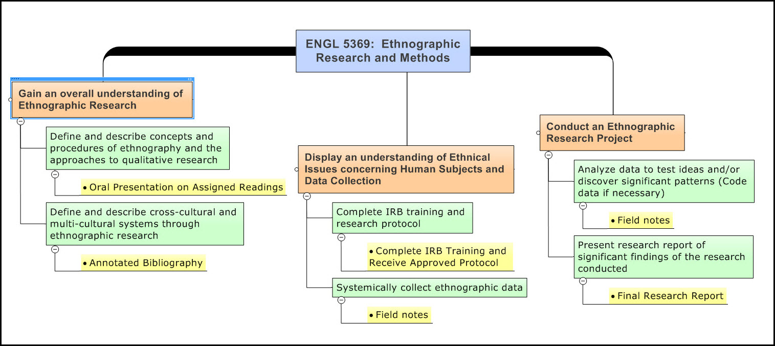

Slide 17
Syllabus Checklist
Course overview:
Teaching approaches / activities
Learning goals
How does the course fit within the program of study?
How do the course goals support the program goals?
How do the course goals align with the general education goals?
(adapted from U. Delaware)

Slide 18
Syllabus Examples
Online syllabus From Danielle Devoss
Syllabus design notes and examples from BYU

Slide 19
Readings Note Example
Guide to the Readings
Course: Eastern European History: 1918 to Present
I want to take a moment to clarify how I hope you will approach the readings. First, don't take the readings as gospel. Just because something is printed does not make it Absolute Truth. Be critical of what you are reading, drawing upon your own experiences and other knowledge. I have chosen many readings precisely because they are provocative. If you find yourself strongly disagreeing with a particular reading, that's fine; indeed, I encourage strong disagreement. However, if you disagree, you must clarify in your mind the reasons and evidence upon which you are basing your disagreement.
At the same time, keep an open mind. Listen to what the readings have to say. Think about what experiences you may have had and reading you have done that may corroborate the course readings. Give yourself time to reflect on the information offered in the readings. These are not readings to be run through rapidly. Take your time with them; allow yourself to enter into a kind of conversation with them.
(adapted from U. Delaware)

Slide 20
Academic Integrity Example
Here are some practices that are acceptable:
Getting procedural advice from B&E lab consultants.
Discussing ideas about assignments with fellow students.
Showing a classmate how to do a computer procedure (or getting help with a procedure in this way).
Getting help from your instructor.
Here are some practices that are not acceptable:
Copying (by whatever means) another student's work or duplicating another student's problem solving steps. This means it is not acceptable to do an assignment by having another student dictate the assignment's keystrokes to you, or to let another student do things for you.
Submitting another student's work, in whole or in part, as your own on an assignment or examination.
Copying (electronically or by hand) someone else's computer file, modifying it, and handing it in as your own work.
Having someone load his/her assignment into the computer, then modifying it and handing it in as your own work.
Working with other students in unauthorized ways, in order to complete assignments; e.g., working in a team of 3, when teams of 2 are specified.
Allowing another person to copy all or part of your work, to hand in as their own. Thus, you should not provide a paper or electronic copy of your work to a classmate to use as a "reference" in doing their work. And you should not post your work to a web site or to an electronic bulletin board, or similar medium, for reference by others.
(adapted from U. Delaware)

Slide 21
Assignment Design
I. Initial questions
II. Learning Outcomes
III. Getting Specific
IV. From Assignment to Assignment Sheet

Slide 22
Initial Questions
What is the assignment?
What are my goals for a particular assignment?
Where does this assignment fit within my course, field?
What new skills and concepts does this assignment involve?
What prior skills and concepts are involved?
How do I best communicate what I want for this assignment?

Slide 23
Learning Outcomes
What learning goals does this assignment promote?
How will these goals be assessed?
How will these goals and assessment measures be communicated?

Slide 24
Getting Specific
What is the audience and purpose of the assignment?
What is the disciplinary character of the assignment?
What are the specific tasks of the assignment?
What are the stages of the assignment?
What are the necessary and available resources for the assignment?
What kinds of framing and support are required for this assignment?

Slide 25
From Assignment to Assignment Sheet
What do students need to know, and when?
How much information is too much?
What necessary and useful information must the assignment sheet include?
What caveats, models, milestones, formalities and rubrics do you include?

